Slide 1
The Word Within the Word
List 5

Slide 2
vita
life
vitamin
vital
revitalize

Slide 3
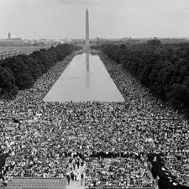
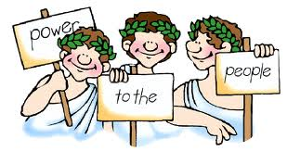
demo
people
democracy
demonstrate
demographics

Slide 4
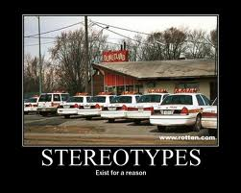
stereo
solid
stereotype
stereoscope

Slide 5
ism
doctrine
Marxism
capitalism

Slide 6
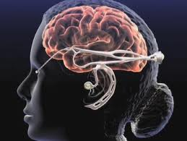
cogn
know
recognize
incognito
cognizant

Slide 7
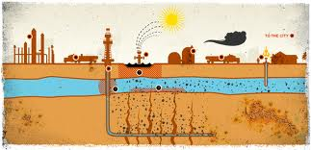
sur
over
surpass
surplus
surcharge
surface

Slide 8
alter
other
alternator
alteration
alternative

Slide 9
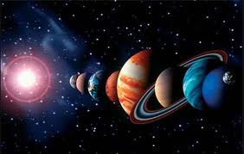
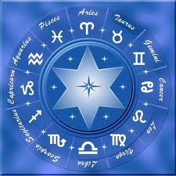
astr
star
astronomy
astrology
asteroid
asterisk

Slide 10
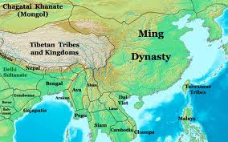
dyna
power
dynamic
dynamite
dynamo
dynasty

Slide 11
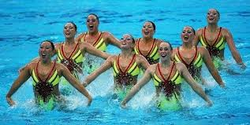
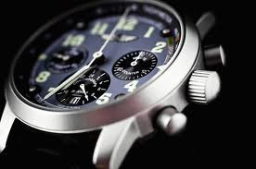
chron
time
chronological
chronic
synchronize

Slide 12
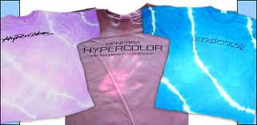
hyper
over
hyperactive
hypertension
hyperbole

Slide 13
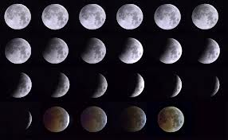
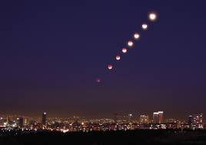
luna
moon
lunar
lunatic

Slide 14
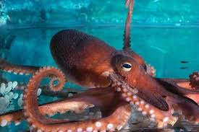
octa
eight
octagon
octopus
octave

Slide 15
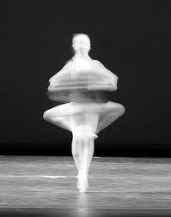
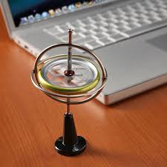
gyro
turn
gyration
gyrate
gyroscope

Slide 16
contra
against
contradict
contrary
contrast

Slide 17
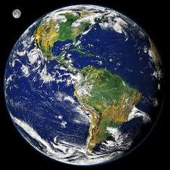
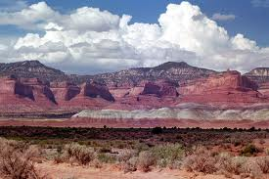
geo
earth
geography
geology

Slide 18
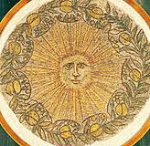
helio
sun
Helios
heliotrope
heliograph

Slide 19
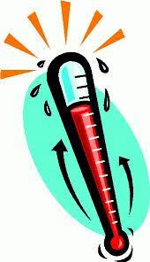
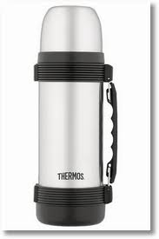
thermo
heat
thermometer
thermostat
thermos

Slide 20
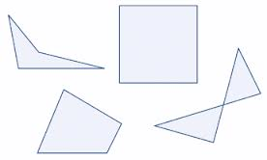
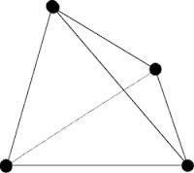
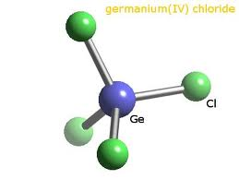
tetra
four
tetragon
tetrachloride
tetracycline

Slide 21
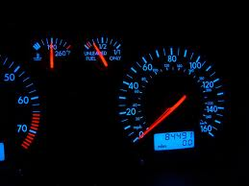
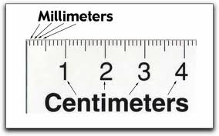
meter
measure
thermometer
odometer
millimeter

Slide 22
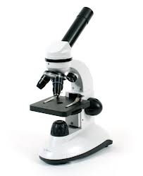
scope
look
periscope
telescope
microscope

Slide 23
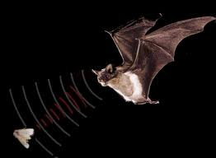
son
sound
sonar
song
sonnet

Slide 24
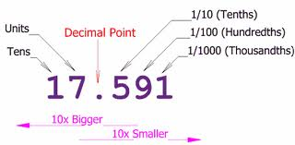
dec
ten
decathlon
decimal
decade

Slide 25
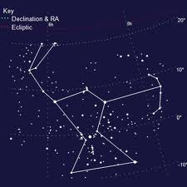
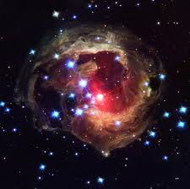
stell
star
stellar
constellation

Slide 26
amat
love
amatory
amateur
amiable

