Slide 1
The Word Within The Word
List 4

Slide 2
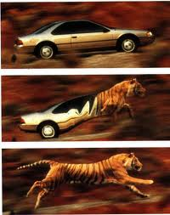
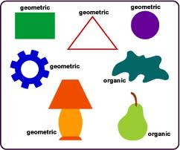
morph
shape
amorphous
anthropomorphism
metamorphosis

Slide 3
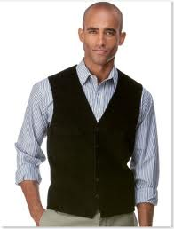
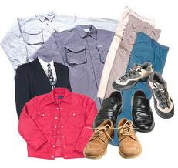
vest
clothes
revest
vestment
vested

Slide 4
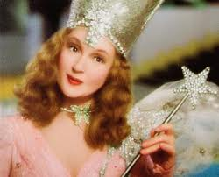
bene
good
benediction
benefit
benefactor
benevolent

Slide 5
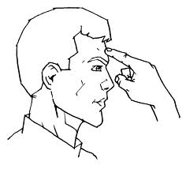
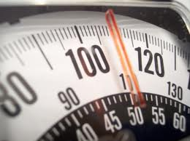
pond
weight
ponder
imponderable
ponderous

Slide 6
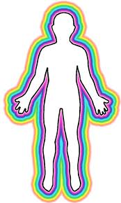
corp
body
corporal
corporation
corpulent
corpse

Slide 7
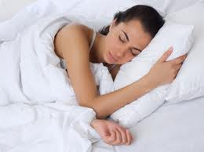
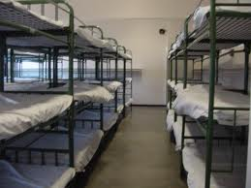
dorm
sleep
dormitory
dormant
dormer
dormancy

Slide 8
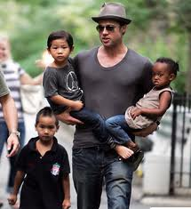
pater
father
paternalistic
patronize
patriarch
expatriate

Slide 9
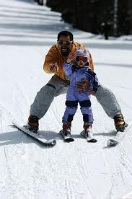
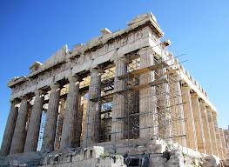
nov
new
novel
novice
innovation
renovate

Slide 10
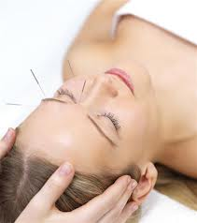
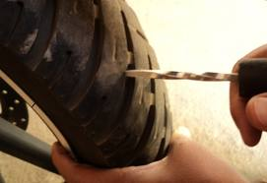
punct
point
puncture
punctuate
acupuncture
punctual

Slide 11
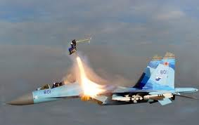
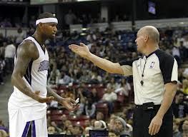
ject
throw
eject
reject
inject
interject

Slide 12
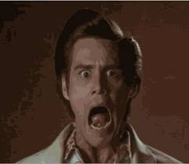
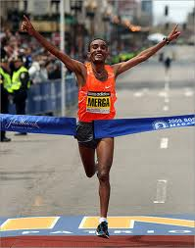
tion
act or
state
completion
reaction
devastation
creation

Slide 13
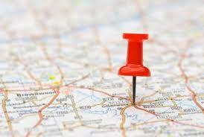
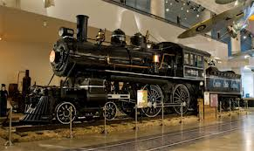
loco
place
locomotive
location
local
dislocate

Slide 14
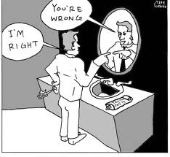
dox
opinion
orthodox
paradox
doxology

Slide 15
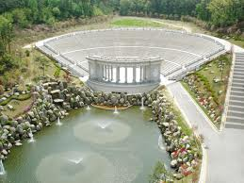
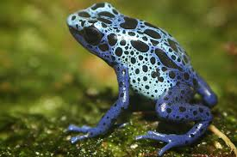
amphi
both
amphibious
amphitheater

Slide 16
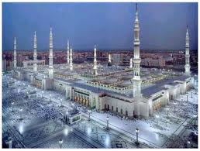
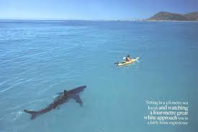
magn
great
magnificent
magnanimous
magnate
Magna Carta

Slide 17
eu
good
euphemism
Europe
eugenics
eulogy

Slide 18
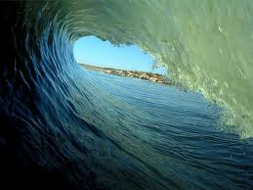
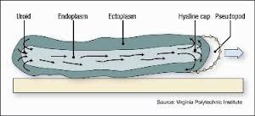
endo
within
endoplasm
endoskeleton
endothermic
endocrine

Slide 19
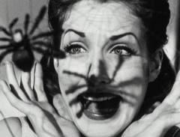
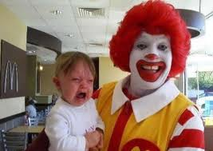
phobia
fear
claustrophobia
hydrophobia
coulrophobia
arachnophobia

Slide 20
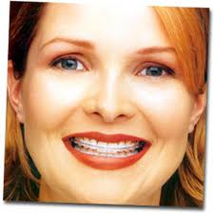
ortho
straight
orthodontics
orthopedic
orthodox

Slide 21
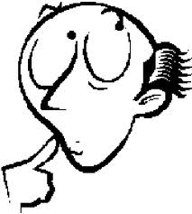
put
think
dispute
computer
disreputable
reputation

Slide 22
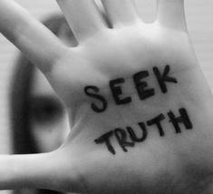
ver
true
verify
verdict
verisimilitude
veracity

Slide 23
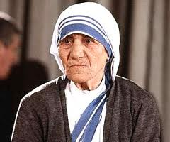
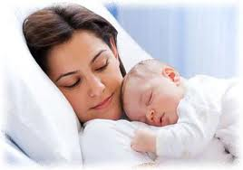
matri
mother
matricide
matron
matrimony
matriarch

Slide 24
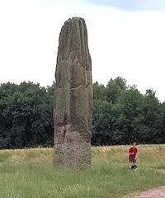
mega
large
megalith
megaphone
megalomania
megaton

Slide 25
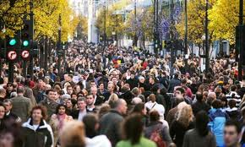
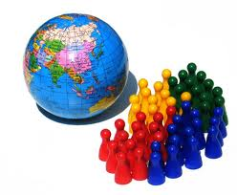
pop
people
popular
population
populate
populous

Slide 26
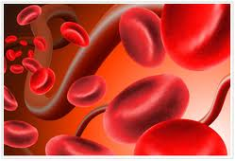
sangui
blood
sanguine
consanguinity
sangfroid
sanguinary

