Slide 1
The Word Within The Word
List 3

Slide 2
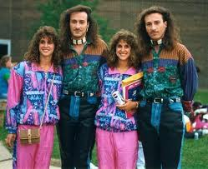
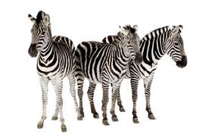
homo
same
homogenize
homonym
homophones
homologous

Slide 3
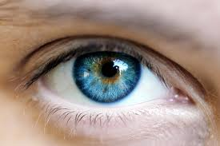
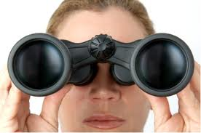
spec
look
spectacles
inspect
specter
spectrum

Slide 4
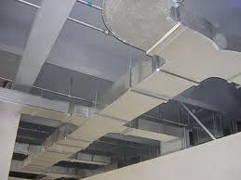
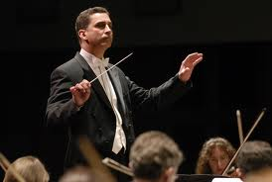
duct
lead
conductor
ductile
induct
product

Slide 5
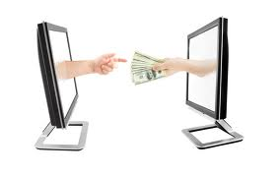
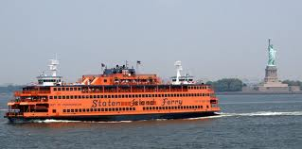
fer
carry
transfer
infer
ferry
aquifer

Slide 6
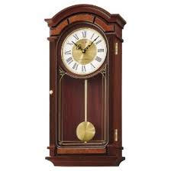
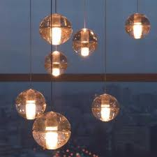
pend
hang
pendant
pendulum
suspend
impending

Slide 7
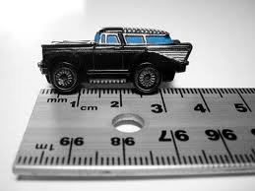
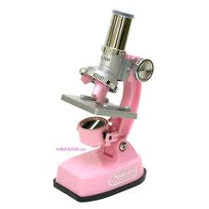
micro
small
microscope
microphone
microbiology
microcosm

Slide 8
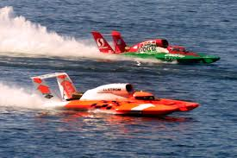
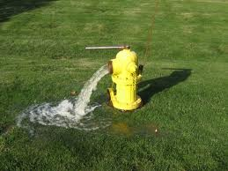
hydro
water
dehydrate
hydroplane
hydroponics
hydrant

Slide 9
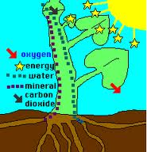
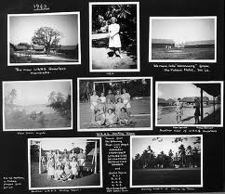
photo
light
photograph
photon
photogenic
photosynthesis

Slide 10
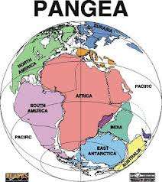
pan
all
panorama
pantheism
Pangea
pandemic

Slide 11
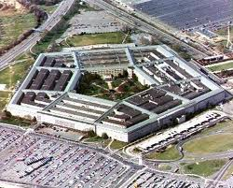
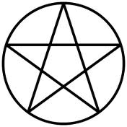
penta
five
pentagram
pentagon
pentameter
pentathlon

Slide 12
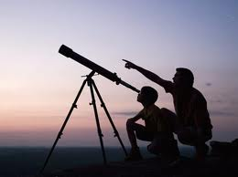
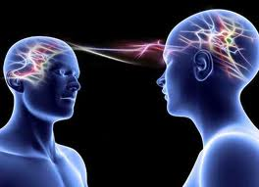
tele
far
telescope
telephone
telepathy
telekinesis

Slide 13
vid
look
video
evidence
invidious
vide

Slide 14
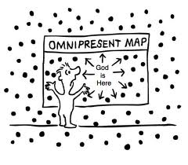
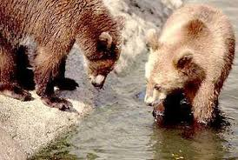
omni
all
omnipotent
omniscient
omnipresent
omnivore

Slide 15
ex
out
exit
extract
excise
except

Slide 16
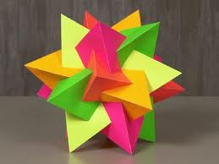
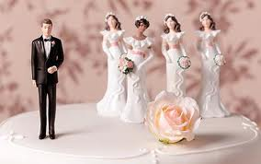
poly
many
polygamy
polyphony
polyhedron
polyester

Slide 17
re
again
return
reuse
retouch
reiterate

Slide 18
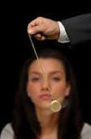
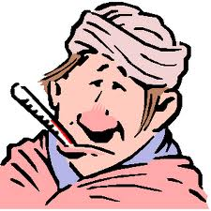
hyp
under
hypothesis
hypnotize
hypocrite
hypothermia

Slide 19
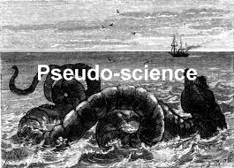
pseudo
false
pseudonym
pseudoscience
pseudopod
pseudomorphic

Slide 20
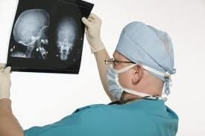
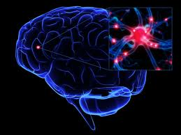
neuro
nerve
neuron
neurologist
neurosurgeon
neurosis

Slide 21
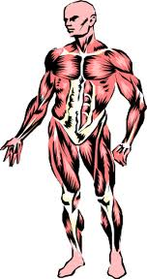
tomy
cut
tonsillectomy
appendectomy
dichotomy
anatomy

Slide 22
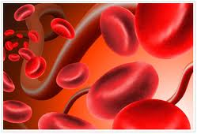
hema
blood
hematoma
hematology
hematite
hematogenesis

Slide 23
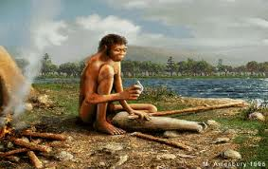
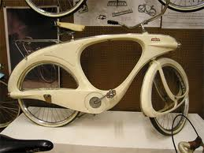
proto
first
prototype
protohuman
proton
Protozoa

Slide 24
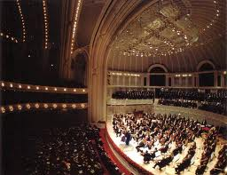
phon
sound
symphony
telephone
phonograph
cacophony

Slide 25
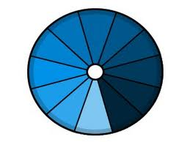
mono
one
monotonous
monolithic
mononuclear
monotone

Slide 26
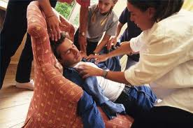
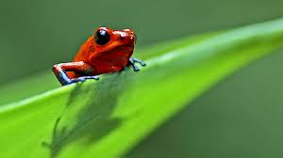
viv
life
vivid
vivacious
convivial
revive

