Slide 1
The Word Within The Word
List 2

Slide 2
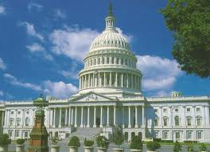
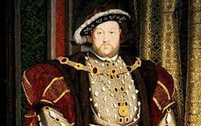
archy
government
monarchy
anarchy
matriarchy
patriarchy

Slide 3
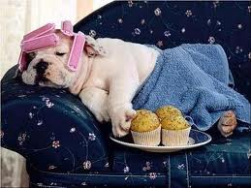
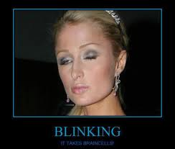
-ard/-art
always
dullard
braggart
blinkard
sluggard

Slide 4
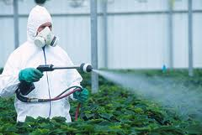
cide
kill
pesticide
genocide
patricide
regicide

Slide 5
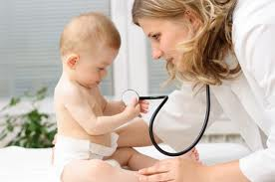
-ician
specialist
technician
pediatrician
electrician

Slide 6
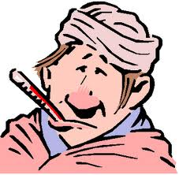
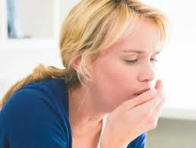
-itis
infection
dermatitis
arthritis
bronchitis
gingivitis

Slide 7
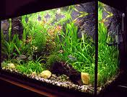
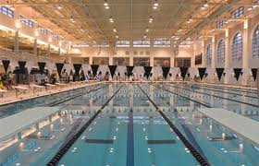
aqua
water
aquatic
aquarium
aquaplane

Slide 8
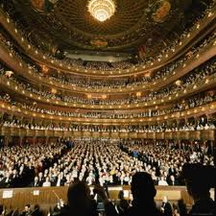
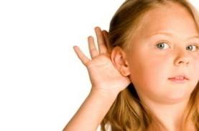
audi
hear
auditory
audio
audience
auditorium

Slide 9
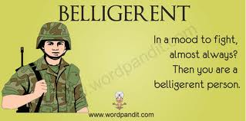
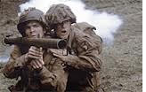
bell
war
belligerent
bellicose

Slide 10
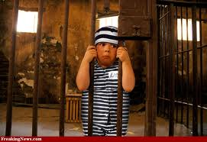
cap
take
captured
captives
captious
captivated

Slide 11
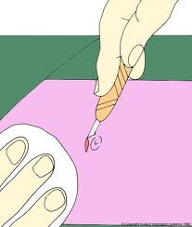
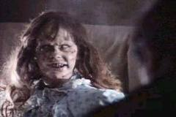
cise
cut
incised
excise
exorcise

Slide 12
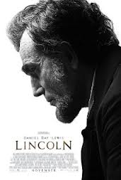
bio
life
biome
biography
biology
biopic

Slide 13
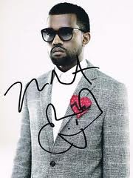
auto
self
autobiography
autonomy
autocracy
autograph

Slide 14
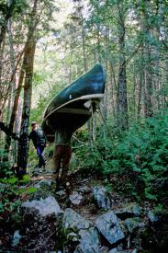
port
carry
porter
portable
portage

Slide 15
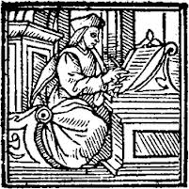
scrib
write
inscribe
scribes
scribble
circumscribe

Slide 16
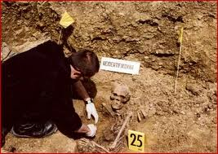
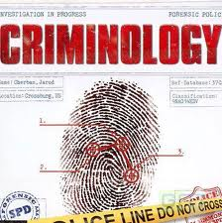
-logy
science
entomology
anthropology
criminology
meteorology

Slide 17
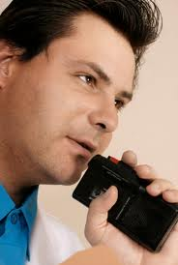
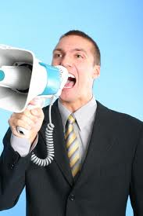
dict
say
indictment
contradict
dictate
diction

Slide 18
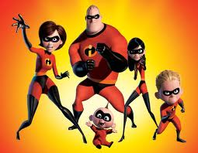
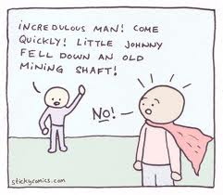
cred
believe
incredulous
incredible
accredited
discredited

Slide 19
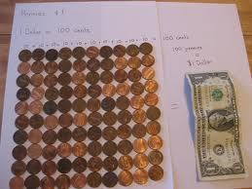
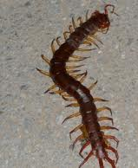
cent
one hundred
centipede
century
centenarian
centennial

Slide 20
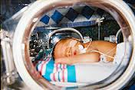
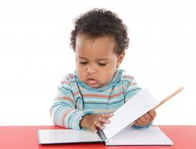
neo
new
neophyte
neonatal
neoclassical

Slide 21
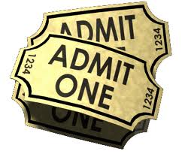
ad-
to
adhere
admit
adhesive

Slide 22
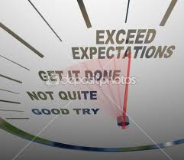
cede/ceed
go
recede
proceed
exceed

Slide 23
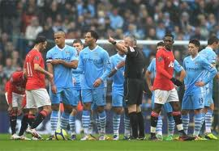
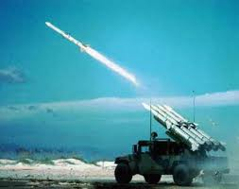
miss
send
dismiss
remiss
missile

Slide 24
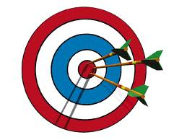
centri
center
concentric
eccentric
centripetal
centrifuge

Slide 25
biblio
book
bibliophile
bibliography
bibliomania

Slide 26
anthropo
man
misanthropist
philanthropy
anthropology
anthropomorphism

